Slide 1
Above State Training - Soil Survey
National Technology Support Centers and SPSD
November 14th, 2022| CNTSC, ENTSC, SPSD and WNTSC

Slide 2
Overview
Soil Survey Geographic Database (SSURGO)
SSURGO datasets consist of spatial data, tabular data, and information about how the maps and tables were created. The extent of a SSURGO dataset is a soil survey area, which may consist of a single county, multiple counties, or parts of multiple counties. SSURGO map data can be viewed in the Web Soil Survey or downloaded in ESRI® Shapefile format
Examples of information available from the database include hydric soil ratings, farmland classification, available water capacity, soil reaction, electrical conductivity, and frequency of flooding; yields for cropland, woodland, rangeland, and pastureland; and limitations affecting recreational development, building site development, and other engineering uses
A complete SSURGO dataset consists of:
GIS data (as ESRI® Shapefiles)
attribute data (dbf files - a multitude of separate tables)
database template (MS Access format - this helps with understanding the structure and linkages of the various tables)
metadata

Slide 3
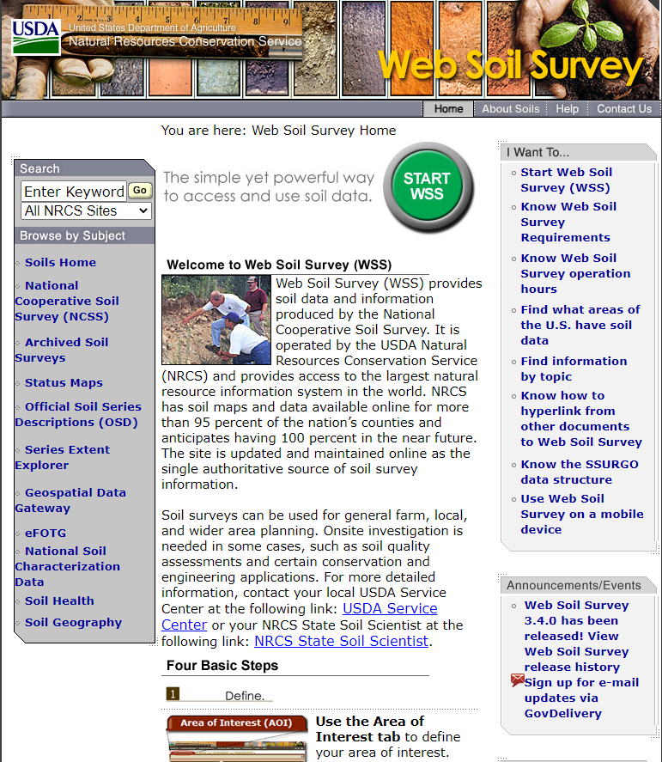
Overview
Historical Usage of Soils Data
Before there was the Web Soil Survey (WSS) there was a published soil survey
NRCS released WSS in 2005 to provide better public access to national soils data and mapping and made the availability of interpretive products available for download and inclusion into conservation plans
Today, Conservation planners access soils data via Web Soil Survey and also through geospatial methods such as: GeoPortal, Conservation Desktop, Soil Data Viewer

Slide 4
Overview
Historic Process
Official soil survey data was updated on an ad hoc basis and new data was published whenever a State or island territory decided it was appropriate
Official soil survey data was updated continuously throughout the year
The continuous update process was acceptable as most projects were initial soil surveys or extensive revisions of the entire SSA
Update frequency significantly increased in the last 10 to 15 years as SPSD projects shift from initial to MLRA updates
Internal USDA soil survey customers experienced data instability

Slide 5
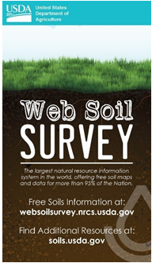
Overview
What is the Annual Soils Refresh (ASR)?
The annual process by which all states and island territories simultaneously refresh their publicly available official soil survey information
Incorporates updates to published Soil Survey Areas (SSAs), publishes new SSAs, validates soil survey data, and ensures all published SSAs include the same set of required national interpretations
Refreshes data available through Web Soil Survey (WSS) and Soil Data Access (SDA)
The official soil survey database was refreshed on October 1, 2022, and this data is now available to the public through Web Soil Survey (WSS) or Soil Data Access (SDA).

Slide 6
Above State Training – Soil Survey
Conservation Desktop and Web Soil Survey

Slide 7
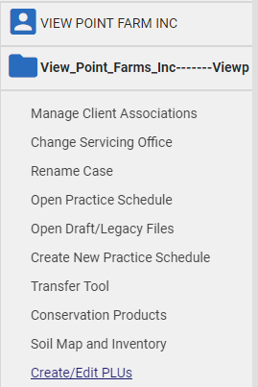
Export Land Units from Conservation Desktop – Import into Web Soil Survey
1. Open a case file and select
Create/Edit PLUs.

Slide 8
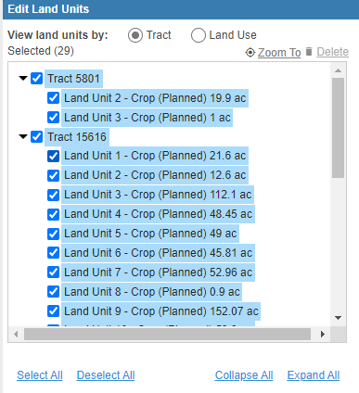
Export Land Units from Conservation Desktop – Import into Web Soil Survey
2. Select Land Units to include with the check boxes or the ‘Select All’ option.

Slide 9

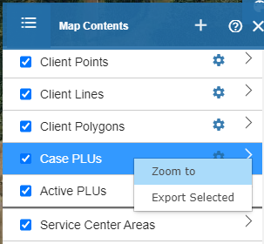
Export Land Units from Conservation Desktop – Import into Web Soil Survey
3. Open the Map Contents from center toolbar.
4. Right click on Case PLU’s.
Choose Export Selected.

Slide 10
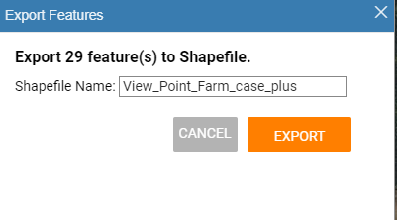
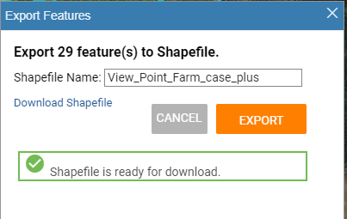
Export Land Units from Conservation Desktop – Import into Web Soil Survey
5. Select Export.
Optionally edit the shapefile name.
6. Select Download Shapefile.

Slide 11
Conservation Assessment Ranking Tool Soils
May 2, 2019
11/14/2022 – Jason Nemecek and Richard Reid

Slide 12
How is Geospatial Data Used in CART

Slide 13
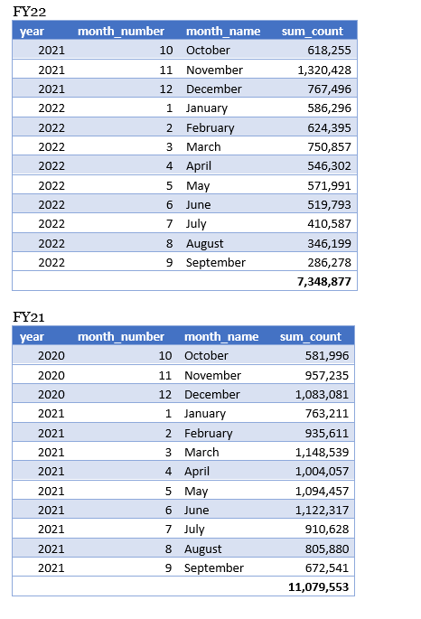
Usage
Notes:
Just a quick reference. What you are looking at is the metrics of how many times the soils information is being used in CART. Some of the soil services are missing so it doesn’t reflect all the numbers, but this is what we can tract.

Slide 14
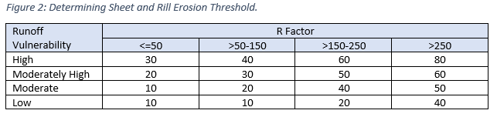
Threshold
Measure of Intrinsic Site Vulnerability and amount of conservation effort to reach a “sustainable” level
From NB 440-19-9, Attachment A – CART Resource Concern Assessment
Soil Erosion – Sheet and Rill
Notes:
With the advent of CART, we had the challenge and opportunity to rapidly accelerate soil data delivery into the conservation planning and ranking process. Many of our soil interpretations and the methods we use to create them fit well with the concepts of resource concerns on a field and the limitations or assumptions that CART uses.
During the planning and assessment process, the conservationists select the resource concerns that they want to assess with the producers. CART assessments operate on a “most limiting factor” assumption for conservation treatment needs, which aligns with our soil interpretations and limitations algorithms. A field can be designated high risk if a significant extent of the spatial boundary (the planning land unit (PLU), boundary drawn by the conservationists) has a limiting factor for the resource concern being evaluated by the conservationist. If the planner selects this resource concern component for assessment. The soil web service will be used to determine the percentage of soils

Slide 15
Soil Quality Degradation
 | Resource Concern | Soil Interpretation
1 | Subsidence | Agricultural Organic Soil Subsidence
2 | Compaction | Soil Susceptibility to Compaction
3 | Organic Matter Depletion | Organic Matter Depletion
4 | Concentration of Salts and Other Chemicals | Surface Salt Concentration
Notes:
CART has four resource concerns related to Soil Quality Degradation and each will involve analysis of soil interpretation data from the Soil Data Access Query service. Soil maps and reports for these interpretations are also available from Web Soil Survey. Both applications are connecting to the same soils database. SSURGO information is used in 18 different resource concerns.

Slide 16
Soil Data Access Requests by CART
Park County, Wyoming (245 acres)
Notes:
The request for soils data begins once planned landunits have been selected.
The request is in the form of an SQL query and contains:
Landunit identifier
Bounding coordinates
CART will automatically send the request to Soil Data Access Query Service.
Map layers are processed in the background and will not be displayed

Slide 17
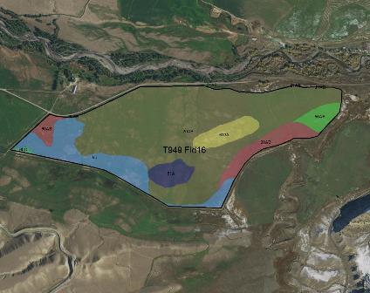
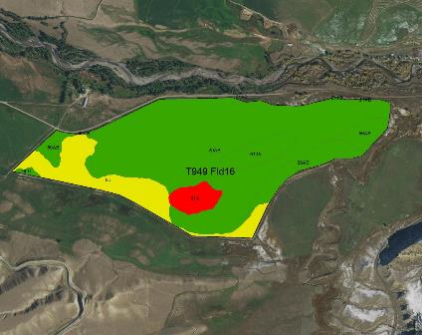
Map data is processed in the background
Basic Soil Map
Risk of Surface Salt Concentration
Notes:
The map on the left shows 8 different soils within this landunit. The map on the right side illustrates risk of surface salinization. The red polygon indicates an area of high risk for surface salinization, yellow areas have a moderate risk and green areas are low risk.

Slide 18
Service Data
Landunit | Soil Interpretation Name | Soil Interpretation Rating | Rating Number | CART Rating | Rating Percent | Rating Acres | Land Unit Acres | Rolling Percent | Rolling Acres
T949 Fld16 | Surface Salt Concentration | High surface salinization risk or already saline | 1 | Surface Salt Concentration:1 | 3.9 | 9.54 | 244.78 | 3.9 | 9.54
T949 Fld16 | Surface Salt Concentration | Surface salinization risk | 2 | Surface Salt Concentration:2 | 15.2 | 37.20 | 244.78 | 19.1 | 46.74
T949 Fld16 | Surface Salt Concentration | Low surface salinization risk | 3 | Surface Salt Concentration:3 | 80.9 | 198.04 | 244.78 | 100.0 | 244.78
Notes:
In the example, the Query service has returned soils data for the ‘Risk of Surface Salt Concentration’ within the landunit. The rating data shown in table below is then used to calculate the magnitude of each rating as both a landunit percentage and as landunit acres.
Areas with the highest risk will be assigned a rating number of 1. Areas with a lower risk will be assigned a larger rating number. Rating values are calculated using soils data at the soil component level.

Slide 19
Landunit Detailed Ratings
Landunit | Soil Interpretation Name | Soil Interpretation Rating | Rating Number | CART Rating | Rating Percent | Rating Acres | Land Unit Acres | Rolling Percent | Rolling Acres
T949 Fld16 | Surface Salt Concentration | High surface salinization risk or already saline | 1 | Surface Salt Concentration:1 | 3.9 | 9.54 | 244.78 | 3.9 | 9.54
T949 Fld16 | Surface Salt Concentration | Surface salinization risk | 2 | Surface Salt Concentration:2 | 15.2 | 37.20 | 244.78 | 19.1 | 46.74
T949 Fld16 | Surface Salt Concentration | Low surface salinization risk | 3 | Surface Salt Concentration:3 | 80.9 | 198.04 | 244.78 | 100.0 | 244.78
Notes:
The service request then calculates the rolling sum values for rating_acres and rating percent for each resource concern and finds the single most limiting rating (per landunit) that comprises at least 10% by area or 10 acres.
In this example, it is the second row that meets these criteria and will be provided to the CART application as the landunit rating for Concentration of Salts and Other Chemicals. It is important to understand that the functionality for calculating landunit ratings is not available from Web Soil Survey. It is only designed to provide soil maps and reports.

Slide 20
Final Landunit Ratings
Landunit | Landunit Ratings | Soil Survey Publication Date
T949 Fld16 | Agricultural Organic Soil Subsidence:4 | WY629 2018-09-14 18:51:24
T949 Fld16 | Organic Matter Depletion:2 | WY629 2018-09-14 18:51:24
T949 Fld16 | Soil Susceptibility to Compaction:1 | WY629 2018-09-14 18:51:24
T949 Fld16 | Surface Salt Concentration:2 | WY629 2018-09-14 18:51:24
Notes:
The final Soil Data Access landunit ratings for each of the resource concerns will be returned to CART for awarding of points. The publication date of the soils data will also be returned to CART as metadata. This will ensure that any of the Soil Quality Degradation ratings can be tied back to a particular version of SSURGO soils data.

Slide 21
This domain table contains an ordered list of all possible rating values.
Line | CART Rating | Soil Interpretation Name | Soil Interpretation Rating Class | Rating Number
1 | Surface Salt Concentration:1 | Surface Salt Concentration | High surface salinization risk or already saline | 1
2 | Surface Salt Concentration:2 | Surface Salt Concentration | Surface salinization risk | 2
3 | Surface Salt Concentration:3 | Surface Salt Concentration | Low surface salinization risk | 3
4 | Surface Salt Concentration:4 | Surface Salt Concentration | Not rated | 4
5 | Soil Susceptibility to Compaction:1 | Soil Susceptibility to Compaction | High | 1
6 | Soil Susceptibility to Compaction:2 | Soil Susceptibility to Compaction | Medium | 2
7 | Soil Susceptibility to Compaction:3 | Soil Susceptibility to Compaction | Low | 3
8 | Soil Susceptibility to Compaction:4 | Soil Susceptibility to Compaction | Not rated | 4
9 | Organic Matter Depletion:1 | Organic Matter Depletion | OM depletion high | 1
10 | Organic Matter Depletion:2 | Organic Matter Depletion | OM depletion moderately high | 2
11 | Organic Matter Depletion:3 | Organic Matter Depletion | OM depletion moderate | 3
12 | Organic Matter Depletion:4 | Organic Matter Depletion | OM depletion moderately low | 4
13 | Organic Matter Depletion:5 | Organic Matter Depletion | OM depletion low | 5
14 | Organic Matter Depletion:6 | Organic Matter Depletion | Not rated | 6
15 | Agricultural Organic Soil Subsidence:1 | Agricultural Organic Soil Subsidence | Severe subsidence | 1
16 | Agricultural Organic Soil Subsidence:2 | Agricultural Organic Soil Subsidence | Moderate subsidence | 2
17 | Agricultural Organic Soil Subsidence:3 | Agricultural Organic Soil Subsidence | Low subsidence | 3
18 | Agricultural Organic Soil Subsidence:4 | Agricultural Organic Soil Subsidence | Mineral soil | 4
19 | Agricultural Organic Soil Subsidence:5 | Agricultural Organic Soil Subsidence | Not rated | 5
20 | Suitability for Aerobic Soil Organisms:1 | Suitability for Aerobic Soil Organisms | Not favorable | 1
21 | Suitability for Aerobic Soil Organisms:2 | Suitability for Aerobic Soil Organisms | Somewhat favorable | 2
22 | Suitability for Aerobic Soil Organisms:3 | Suitability for Aerobic Soil Organisms | Very favorable | 3
23 | Suitability for Aerobic Soil Organisms:4 | Suitability for Aerobic Soil Organisms | Not rated | 4
Notes:
Aligning the soil map units and the fields (PLUs) spatially to make consistent determinations takes some geospatial processing. Since fields are rarely comprised of a single soil map unit with uniform topography, the “dominant critical” area and most limiting factor needs to be identified and rated. The soil data automation scripts perform three steps:
Disaggregate the map unit components
Assign them to the PLU
Determine a rating for that PLU
The soils data scripts essentially disaggregate the components in a map unit and put them in a giant bucket (planned land unit). It then makes a determination on that planned land unit. The aggregation is different from how we normally aggregate data such as dominant condition, weighted average, or dominant component. For CART, what we have been doing is a “dominant critical” aggregation because fields rarely are comprised of a single soil map unit with uniform topography. To ensure that the planned system is adequate for the significant parts of the field or conservation management unit, the “dominant critical” area needs to be identified. The “dominant critical” area is the area of the field that is used to represent the entire field or PLU) for conservation plan development on that field or PLU. The “dominant critical” area is determined at 10% of the area that meets the most limiting factor for the planned land unit. A PLU but that doesn’t mean that the entire PLU needs the same uniform level of treatment. For example, you plan for a terrace or the grassed waterway in the impacted area and not for the entire field.

Slide 22
CART Ranking and Geospatial Data
CART allows for the use of national or state specific data in the development of Ranking Pool display groups
States may be required to use national datasets for some landscape or WLFW initiatives But…….will have the flexibility to use their own geospatial datasets for most of the ranking process.
Notes:
I’m going to present a brief overview of soil geospatial data management and some basics on CD and CART. Disclaimer…. This is not a comprehensive or in-depth guide to the use of CART or CD but is intended brainstorm on the possibilities of using soils data within these platforms. As you know for CART assessments Soil Data Access is queried automatically for the PLU and the soils data is returned. For ranking it’s a different story.
• Ranking
CART allows for the use of national or state specific data in the development of Ranking Pool display groups.
States may be required to use national datasets for some landscape or working lands for wildlife initiatives, but… will have the flexibility to use their own geospatial datasets for most of the ranking process.

Slide 23
CART Ranking and Geospatial Data
Geospatial data can be used in several ways within the ranking process including the following:
Applicability
Category
Program
Resource
Notes:
In CART, Geospatial data can be used in several ways within the ranking process including the following:
• Applicability
A single Applicability Question per ranking pool is allowed in CART version 1. The question can be geospatial and use any polygon geometry to determine the extent of a ranking pool; such as a state boundary, a set of counties, or a specific watershed. The question can also be text based to determine factors such as an application type or participant status for the ranking pool. When CART determines applicable ranking pools for a given assessment it will return only those that return a positive response to the applicability question.
• Category
A single Category Question per ranking pool is allowed in CART version 1 and can be geospatial or text based. Geospatial questions must be polygon geometry and attribute values can be used to determine unique categories. The category question is used for a ranking pool to group applications, so they are ranked with ‘like’ applications. (a good example of using categorical ranking would be by MLRA potentially. All applicants within a certain MLRA would compete against each other whereas, applicants in another MLRA would compete only against those that are within their MLRA.)
• Program
Program questions can be geospatial or text based and are used for Program priorities or policy based ranking questions. They can be configured to be conditional depending on how other questions are answered, can be yes/no, multiple choice and points can be positive or negative.
• Resource
Resource questions can be geospatial or text based and are used for Resource priorities or resource based ranking questions. They can be configured to be conditional depending on how other questions are answered, can be yes/no, multiple choice and points can be positive or negative. The same soil interpretations used in the assessment process could be used here for ranking.

Slide 24
Notes:
We have a number of Geospatial Analysis options available for use within CART. Intersect, Intersect with Percent, Buffer, Contains, Contained, and attribute queries. We won’t go into detail on each one but just know they are available for use.

Slide 25
Notes:
Sure, we could use Web Soil Survey to view soil interpretive ratings for specified conservation practices or for some habitat suitability. Oftentimes, we have too but we could take this a step further and utilize these ratings for screening prior to implementation or to rank contracts.

Slide 26
Soil Data Dev’t Toolbox
Notes:
In this example, Using the Soil Data Development Toolbox, We can create any soil interpretation available on Web Soil Survey for either the “MUPolygon” which is a vector or the “MapunitRaster_10m_AL_202210”. Keep in mind that Raster products can be used to create vector products, but the vector products are the only types that can be used for ranking in CART currently.
In seconds, we can produce a statewide soil interpretive layer file in ArcMap that we can enhance or modify for use in ranking within CART or for viewing in Conservation Desktop. Statewide vector coverages can be rather large so additional processing may be necessary. We can dissolve these features based on overall mapunit rating to create categories. We could set up funding pools based on only the most suited soils while excluding the soils that are not suited.

Slide 27
How do we want to evaluate this geospatial data in the ranking process?
Applicability
Category
Program
Resource
Notes:
With a little GIS help we can turn the soil interpretive layer into a layer to be shared to geoportal for use in CD and/or CART for contract ranking based on those areas that are not suited and those areas that are suited to some degree for burrowing habitat. Ask yourself, How would you evaluate this data in CART? This picture is a great example of the use of soil interpretative data for ranking.

Slide 28
Managing Geospatial Data for Soils
Notes:
So let’s talk a little about how to get the geospatial data into CD and CART.
Here is a Screenshot of geoportal – which is the gateway to getting geospatial data into Conservation Desktop.
As most of you may be aware, data first has to be shared from ArcPro to Geoportal or GIS-states to be accessible in Conservation Desktop.
I’ve been told that If the data is to be used for CART it MUST be stored in geoportal. If it’s viewable data it can be stored in CD.
To find relevant content you can navigate to Groups→My Organization’s Groups.

Slide 29
Managing Geospatial Data for Soils
Notes:
Here is a Screenshot of GIS-States Geoportal – The purpose of the GIS-States portal is to support mobile workflows and the data associated with those mobile workflows.
Again, under Groups→My Organization’s Groups we have the Conservation Desktop Users Group which houses all Conservation Desktop facing geospatial content.
How does this relate to soils data. Soil Interpretive layers can be created, modified, or enhanced in ArcPro using a suite of
available SSURGO tools such as the Soil Data Development Toolbox, SSURGO on Demand, Soil Data Viewer, among others
They can be published to Geoportal or GIS-States for use in Conservation Desktop as screening or ranking tools.
Geospatial content published to Geoportal or GIS-States Portal must be saved in the group “Conservation Desktop Users” to be available in CD/CART.

Slide 30
Notes:
For Viewing in Conservation Desktop, we can add a soil interpretive layer as a service. We can make the layer available to only CD or to CART or both. Next, click on the “test connection” button.

Slide 31
Notes:
Clicking on the test connection button will let us see the spatial representation of the data.
Here is an example of the Gopher Tortoise Burrowing Suitability interpretation for Alabama.
Notice that the interpretive dataset has been refined to include only those counties that occur in the WLFW project boundary.
The gopher tortoise example we saw in the previous slides was created for ranking purposes.
The individual mapunit ratings were dissolved and aggregated to a coarser resolution for answering questions.
This dataset has a much finer resolution and is more suitable for viewing the data.
The finer resolution data might be good for screening prior to implementation of a conservation practice while the coarser interpretive data could be used for program ranking to ensure program equality and a more science-based approach.

Slide 32
Notes:
Here is the Configuration page example in Conservation Desktop – this configuration page allows you to supply CD and CART or just CD or just CART with the geospatial dataset for ranking, viewing, etc…
This layer contains soils suitable for Gopher Tortoise burrows as identified by the WLFW priority areas throughout Alabama. Soils are identified as, (Highly Suitable, Less Suitable, Marginal, and Moderately Suitable). This particular layer is only going to be used for viewing the interpretive ratings in CD.

Slide 33
Notes:
Add new service
Name the layer
Service type:
Dynamic map service layer
Feature layer
Tiled map
Vector tile

Slide 34
Notes:
Here is an example of some ranking questions, answers, and points awarded from Alabama.
Again, notice we have applicability, category, resource, and program questions.

Slide 35
Notes:
Soils data can be used from a soil interpretation such as an Alabama gopher tortoise burrowing suitability. In this example, a soils layer for longleaf pine suitability was used to answer this question. Are we able to grow longleaf on these soils? Are these soils suitable for gopher tortoise burrowing?

Slide 36
Summary
Geospatial layers can be used in CD to view (depth to
restriction, gopher tortoise suitability) or can be
configured further for use in CART ranking
Staff has to provision the data from ArcPro to Geoportal to CD after the Annual Refresh to be used in CD and CART (for ranking and viewing/not assessment which runs on SDA)
Public cannot see geoportal so sharing products back and forth is difficult – Local Work Group Meetings
Continued internal agency soils data usage will help refine and enhance the soils data going forward
Notes:
In summary, soils data can be viewed in CD or can be further used in CART ranking.
Either way, staff still has to provision the data from ArcGIS/ArcPro to Geoportal to CD every year when the soils data is refreshed. Allowing some Soil Data Access querying from the ranking side or in CD would greatly reduce staff workload in using soils data.
To end, we need folks to test the soils data and provide feedback. This is a great internal mechanism to do that.

Slide 37
Non-Discrimination Statement
In accordance with Federal civil rights law and U.S. Department of Agriculture (USDA) civil rights regulations and policies, the USDA, its Agencies, offices, and employees, and institutions participating in or administering USDA programs are prohibited from discriminating based on race, color, national origin, religion, sex, gender identity (including gender expression), sexual orientation, disability, age, marital status, family/parental status, income derived from a public assistance program, political beliefs, or reprisal or retaliation for prior civil rights activity, in any program or activity conducted or funded by USDA (not all bases apply to all programs). Remedies and complaint filing deadlines vary by program or incident.
Persons with disabilities who require alternative means of communication for program information (e.g., Braille, large print, audiotape, American Sign Language, etc.) should contact the responsible Agency or USDA's TARGET Center at (202) 720-2600 (voice and TTY) or contact USDA through the Federal Relay Service at (800) 877-8339. Additionally, program information may be made available in languages other than English.
To file a program discrimination complaint, complete the USDA Program Discrimination Complaint Form, AD-3027, found online at How to File a Program Discrimination Complaint and at any USDA office or write a letter addressed to USDA and provide in the letter all of the information requested in the form. To request a copy of the complaint form, call (866) 632-9992. Submit your completed form or letter to USDA by: (1) mail: U.S. Department of Agriculture, Office of the Assistant Secretary for Civil Rights, 1400 Independence Avenue, SW, Washington, D.C. 20250-9410; (2) fax: (202) 690-7442; or (3) email: program.intake@usda.gov.
USDA is an equal opportunity provider, employer, and lender.

